Slide 1

US Beer and Breweries Analysis
Mrinmoy Bhaumik & Tina Pai

Slide 2

Overview
Breweries by state
Data cleaning
ABV and IBU by state
Highest ABV and IBU
ABV and IBU statistics and comparison

Slide 3

How many breweries are present in each state?
Notes:
States tended to have between 0 and 50 breweries
Top states
Bottom states

Slide 4

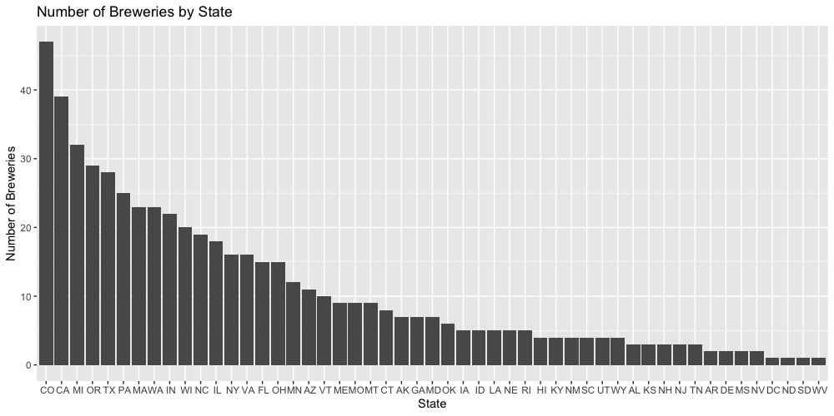
How many breweries are present in each state?
State | Breweries
CO | 47
CA | 39
MI | 32
OR | 29
TX | 28
State | Breweries
MS | 2
NV | 2
DC | 1
ND | 1
SD | 1
Notes:
States tended to have between 0 and 50 breweries
Top states
Bottom states

Slide 5

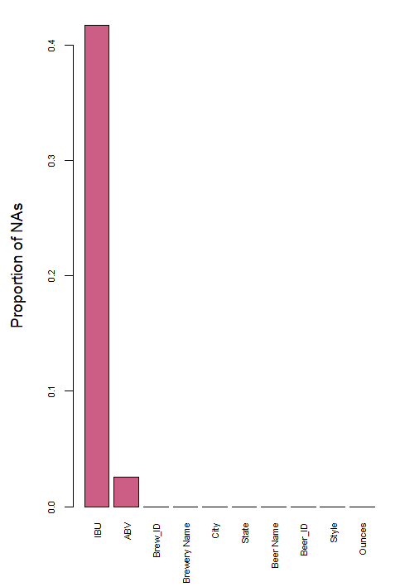
Handling Missing Values
Data has missing values!
NA values make up 40% of IBU data
NA values make up 3% of ABV data

Slide 6
Handling Missing Values
KNN for imputation
Advantage of KNN:
more realistic imputations than filling with the mean while easily comprehensible

Slide 7
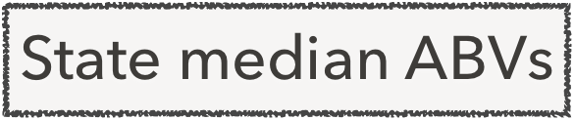
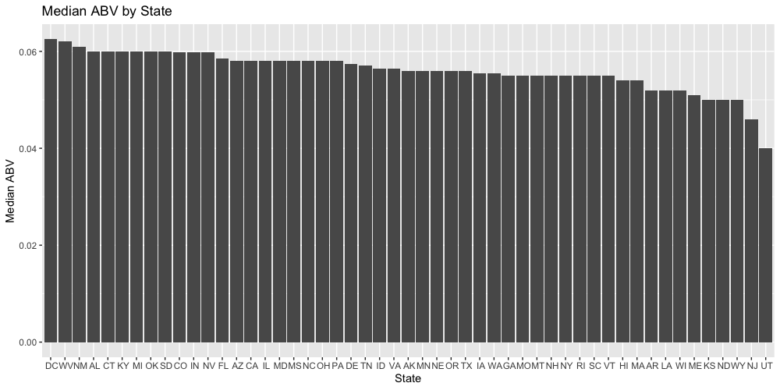

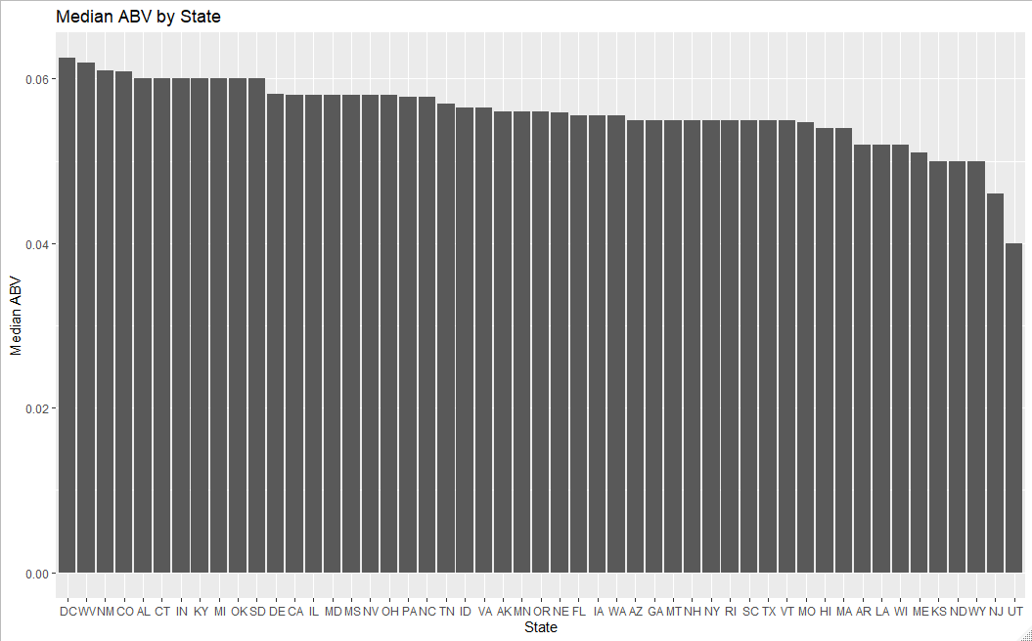
How does ABV vary by state?
ABV imputed by sample mean
ABV imputed by KNN
Notes:
Same states rank top and bottom for both ways of imputation; graphs look more or less the same

Slide 8
How does ABV vary by state?
Highest median ABV: DC, West Virginia, New Mexico
Lowest median ABV: Wyoming, New Jersey, Utah
Notes:
Same states rank top and bottom for both ways of imputation; graphs look more or less the same

Slide 9
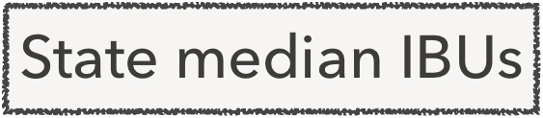
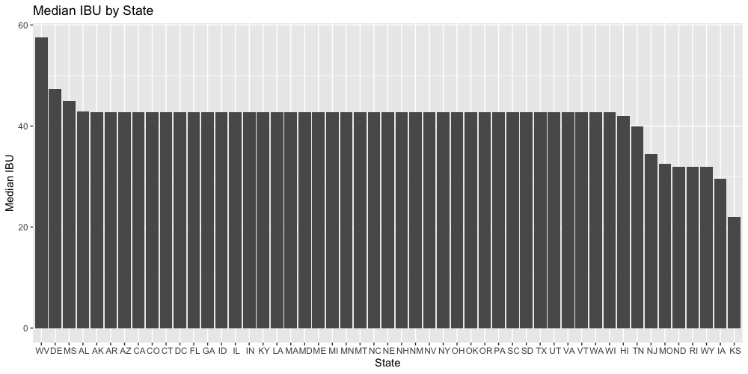
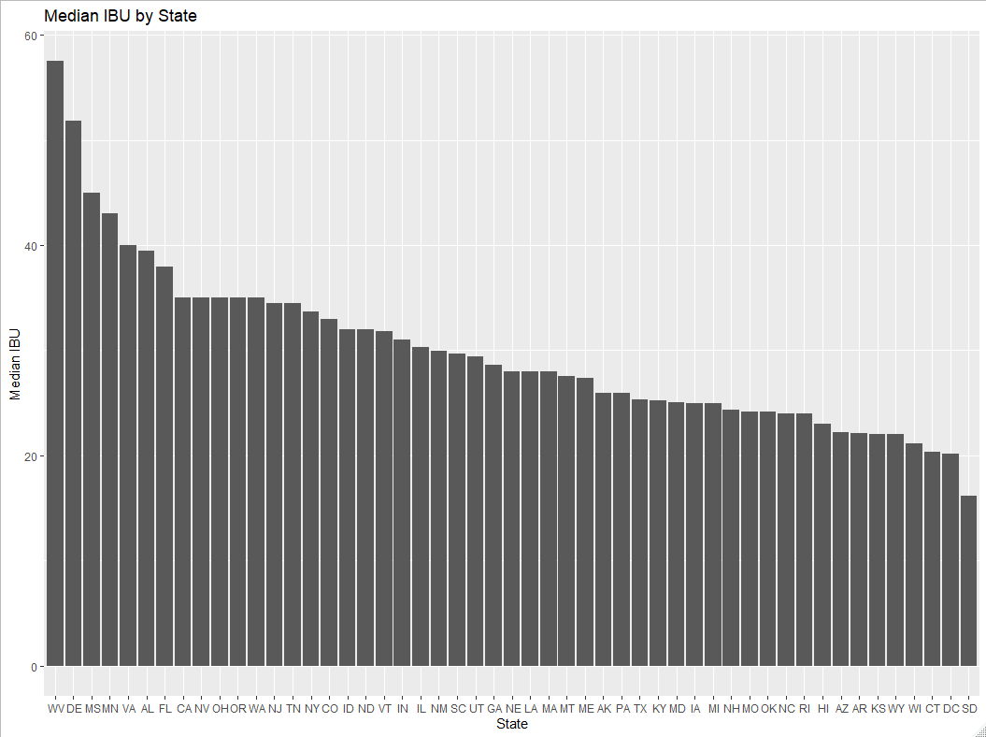
How does ibu vary by state?
IBU imputed by sample mean
IBU imputed by KNN
Notes:
Same states rank top and bottom for both ways of imputation; graphs look more or less the same

Slide 10
How does IBU vary by state?
Highest median IBU: West Virginia, Delaware, Mississippi
Lowest median IBU:
Kansas, Iowa, Wyoming (according to imputation by mean),
or South Dakota, DC, and Connecticut (according to imputation by KNN)
IBU imputed by sample mean
IBU imputed by KNN
Notes:
There were a lot of NAs so you can see the flat line across the IBU imputer by sample mean
The KNN ones are more varied but there’s different states ranking lowest IBU after the imputation, so we just need more better data

Slide 11
Where are beers with highest ABV from?
 | State | Brewery Name | Beer Name | ABV
1 | CO | Upslope Brewing Company | Lee Hill Series Vol. 5 - Belgian Style Quadrupel Ale | 0.128
2 | KY | Against the Grain Brewery | London Balling | 0.125
3 | IN | Tin Man Brewing Company | Csar | 0.120
4 | CO | Upslope Brewing Company | Lee Hill Series Vol. 4 - Manhattan Style Rye Ale | 0.104
5 | NY | Sixpoint Craft Ales | 4Beans | 0.100
6 | MI | Brewery Vivant | Wizard Burial Ground | 0.099

Slide 12
Where are beers with highest IBU from?
 | State | Brewery Name | Beer Name | IBU
1 | OR | Astoria Brewing Company | Bitter Bitch Imperial IPA | 138
2 | VA | Wolf Hills Brewing Company | Troopers Alley IPA | 135
3 | MA | Cape Ann Brewing Company | Dead-Eye DIPA | 130
4 | OH | Christian Moerlein Brewing Company | Bay of Bengal Double IPA (2014) | 126
5 | MN | Surly Brewing Company | Abrasive Ale | 120
6 | VT | The Alchemist | Heady Topper | 120

Slide 13
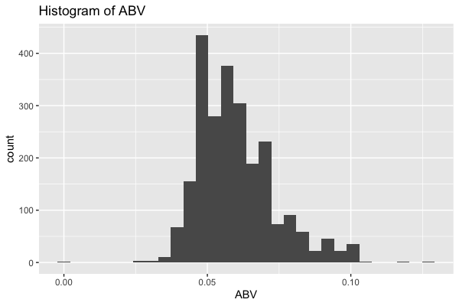
Summary statistics of ABV
Min: 0.00100
1st Qu: 0.05000
Median: 0.05600
Mean: 0.05971
3rd Qu: 0.06700
Max: 0.12800

Slide 14
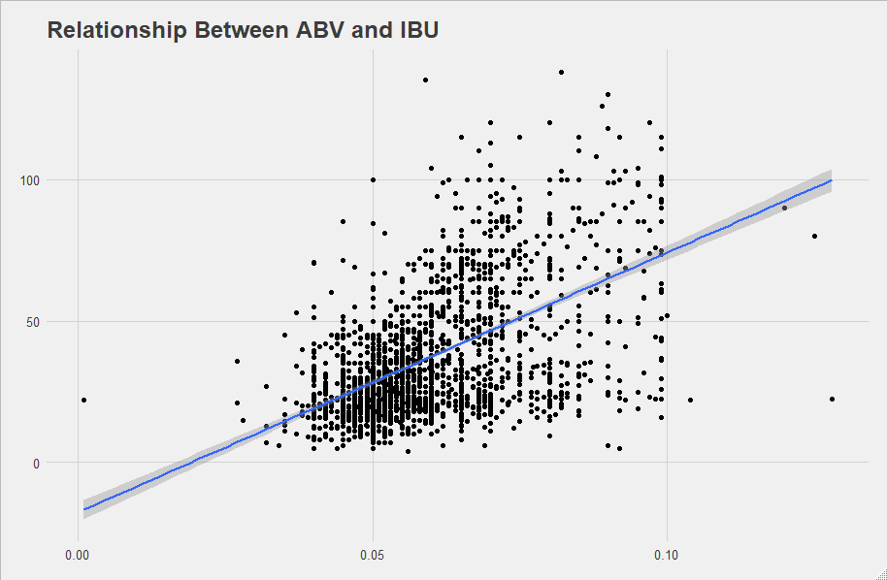
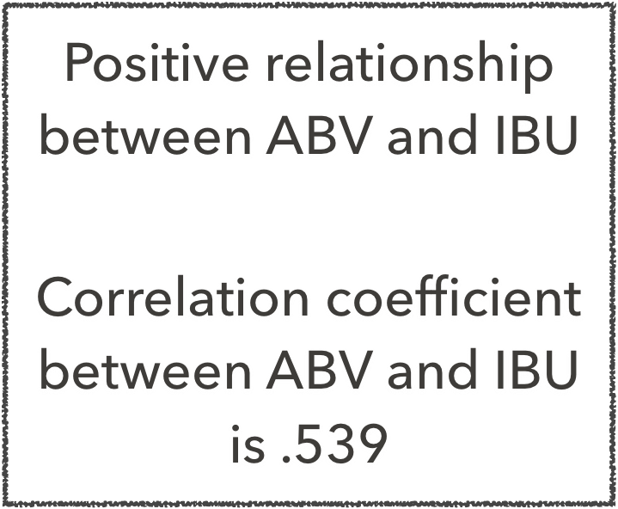
Comparison of ABV and IBU

Slide 15

Most Common Beer Name Words
 | Word | Count
1 | Ale | 591
2 | IPA | 318
3 | Pale | 225
4 | s | 127
5 | Lager | 101
6 | Amber | 73
7 | Stout | 72
8 | Red | 61
9 | Blonde | 60
10 | Wheat | 57
Beer types
Possessive
Colors

Slide 16
Concluding Thoughts
Need more data for IBU
There is a correlation between alcohol content and bitterness
KNN is an effective model for categorizing IPA and other Ales
The most common words used in beer names are beer types and colors

